Slide 1
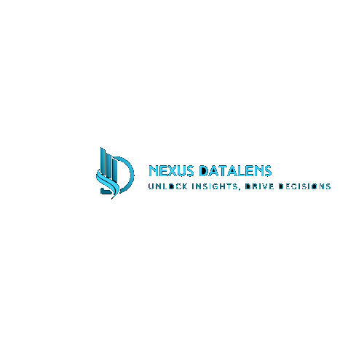

Nexus DataLens: An End-to-End Data Analytics Solution on Cloud (Research Project)

Slide 2

Introduction to Nexus DataLens on AWS
The Nexus DataLens project aims to create a user-friendly, end-to-end data analytics platform. Users can upload files, and AWS automatically processes the data to generate dynamic dashboards using QuickSight.
This project simplifies data workflows by automating file ingestion, data transformation, and visualization, enabling users to gain actionable insights from their data without requiring extensive technical expertise.

Slide 3



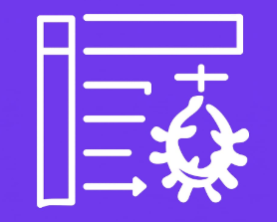
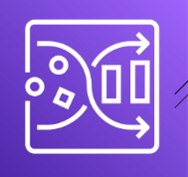

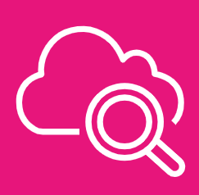



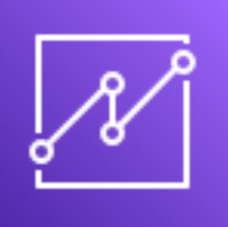
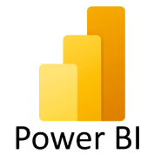
Services
S3 Bucket
AWS Lambda
AWS Glue
(Crawler)
AWS Glue
(Data Catalog)
AWS Athena
AWS
Cloudwatch
AWS Cognito
IAM for Roles
API Gateway
AWS Quicksight
Power BI

Slide 4
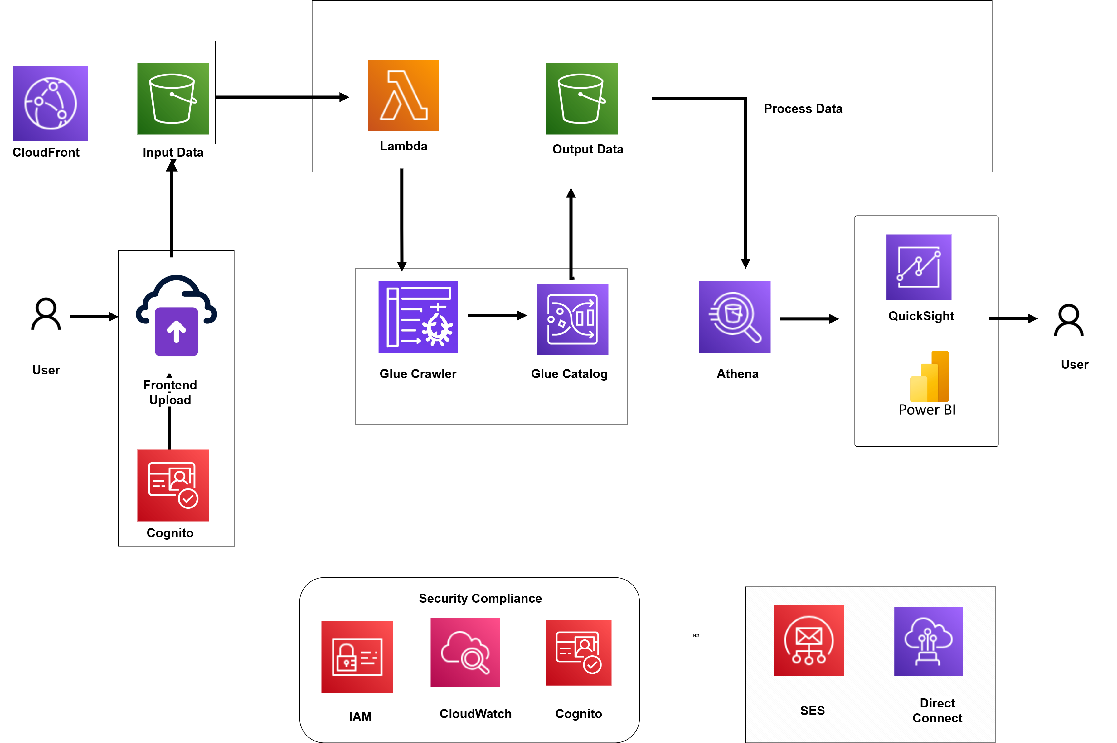
Architecture Overview

Slide 5
Use Case
1
Retail Analytics
2
Financial Risk Management
Analyze sales data to identify trends, optimize pricing, and personalize customer experiences. Leverage customer insights to enhance marketing campaigns.
Monitor financial transactions, identify potential fraud, and manage risk effectively by leveraging data analytics. Optimize investment strategies.
3
Healthcare Analytics
4
College Analytics Dashboard
Analyze patient data to improve diagnoses, personalize treatment plans, and enhance healthcare outcomes. Identify trends and insights for better care.
To provide educators with an interactive dashboard that visualizes student performance, attendance, and engagement data for data-driven decision-making.

Slide 6
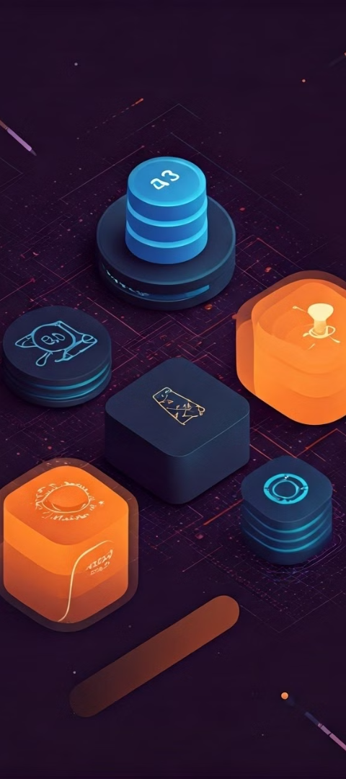
Key Features and Benefits
Business Ready Dashboard
Improved Data Accuracy
1. Enables decision makers to access visualized insights through Power BI or AWS QuickSight
2. Dashboards can be refreshed and reused.
1. Ensures consistent cleaning logic for all uploaded files
2. Avoids human errors during data prep.
User-friendly Frond-end
Global Reach - Cloudfront
1. No technical knowledge needed for users to upload data.
2. Ideal for non-technical stakeholders to submit data.
AWS has a global network of data centers, allowing you to access and process data from anywhere in the world.

Slide 7




Security and Compliance
Data Encryption
Access Control
Data is encrypted at rest and in transit to protect sensitive information.
Granular access controls are implemented to restrict unauthorized access to data.
Auditing and Logging
Detailed logs and audit trails are maintained to track user activity and system events.

Slide 8

Summary
Nexus DataLens is a comprehensive data analytics solution that empowers businesses to leverage the power of AWS cloud services for seamless data processing, analysis, and visualization. With its scalability, flexibility, and security features, Nexus DataLens provides a reliable and efficient platform for data-driven decision-making.

Slide 9

Q&A
This is the time for questions and discussions. Please feel free to ask anything you want.

Slide 10
THANK YOU!

